Slide 1
Abaqus Python
Abaqus Python Scripting
Learn with the concepts
Lec 6 – Writing the field report

Slide 2
Writing the field report
Fastest method to output the data at desired locations.
Integration point
Centroid
Element nodal
Unique nodal
…
Stress, S
As it is a field report, it can output the data ONLY for a frame within a step at a time.

Slide 3
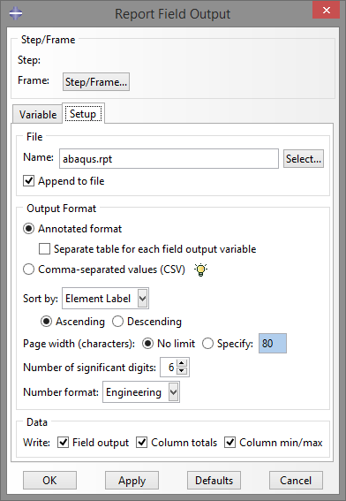
Step-1
17

